Slide 1
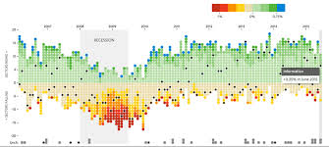
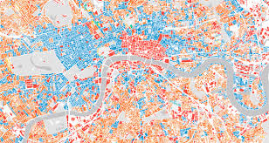

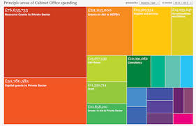
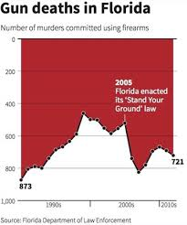
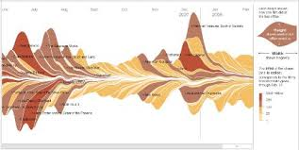
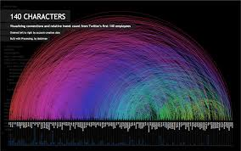
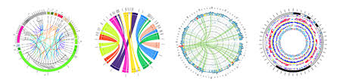
DATA VISUALIZATION: Principles of Design

Slide 2

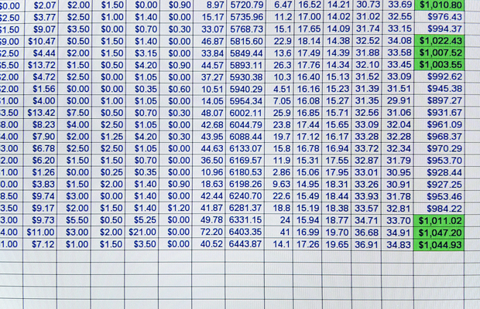
WHY VISUALIZATION
The environment we have to recognize has largely gone from this..
… to this

Slide 3
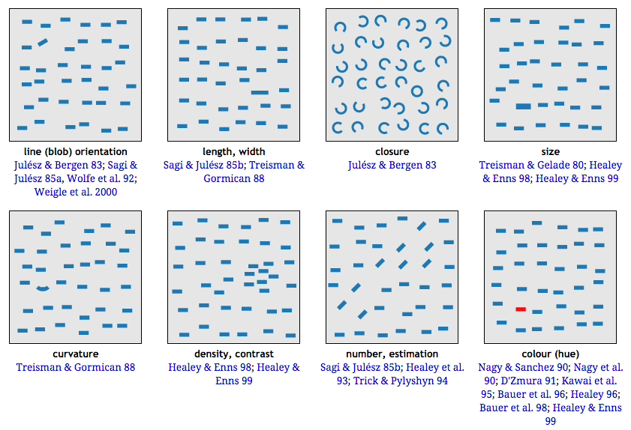
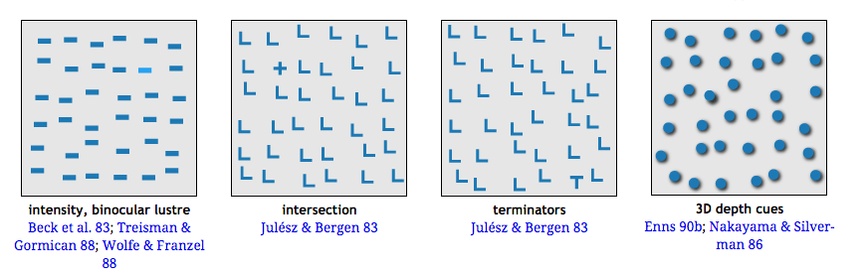
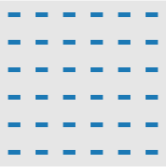
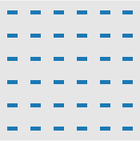
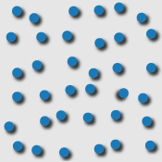
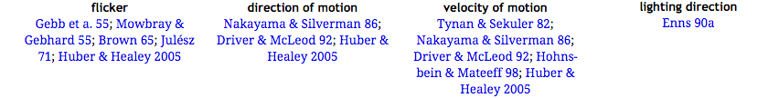
So can we leverage all the processes our brains optimized to help us succeed here..
to help us succeed here?

Slide 4
DATA VISUALIZATION
helps translate numbers into a language our brain understands

Slide 5
How long ago was
400 thousand years?
4 billion years?
In our head, both are FOREVER

Slide 6
400 thousand years

Slide 7
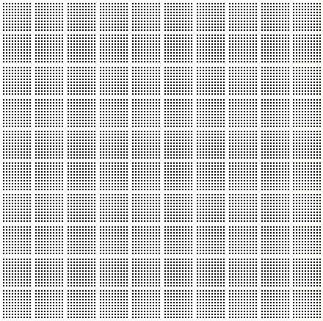
4 billion years
400 thousand years
Notice how it changes your intuition

Slide 8
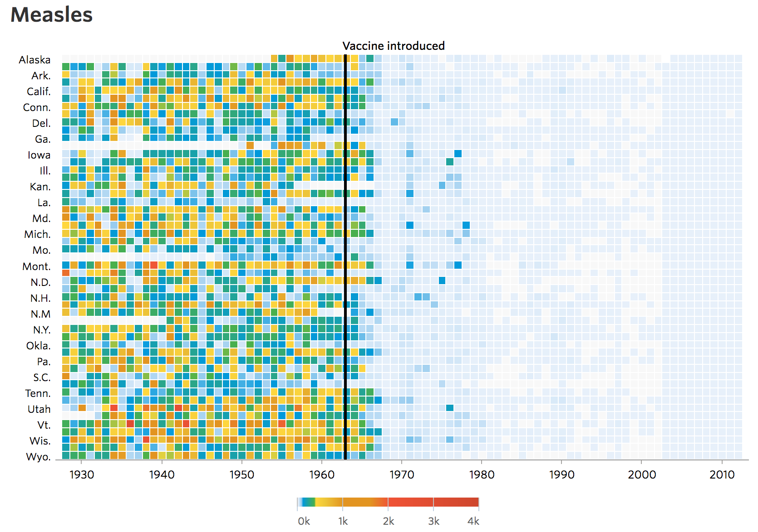
Not just quantity, but time

Slide 9

Charles Minard: Map of Napoleon’s Russian Campaign
Edward Tufte calls this the greatest visualization ever. It shows how Napoleon’s army dwindled as it the temperatures dropped and months went on in Russia. Think about how much info is conveyed in this one graphic!

Slide 10
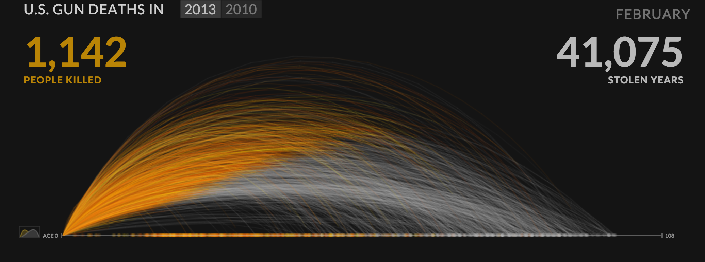
Periscopic: Gun Deaths in 2013
http://guns.periscopic.com/

Slide 11
DATA VISUALIZATION
helps reveal the hidden patterns and structure in the world around us.

Slide 12
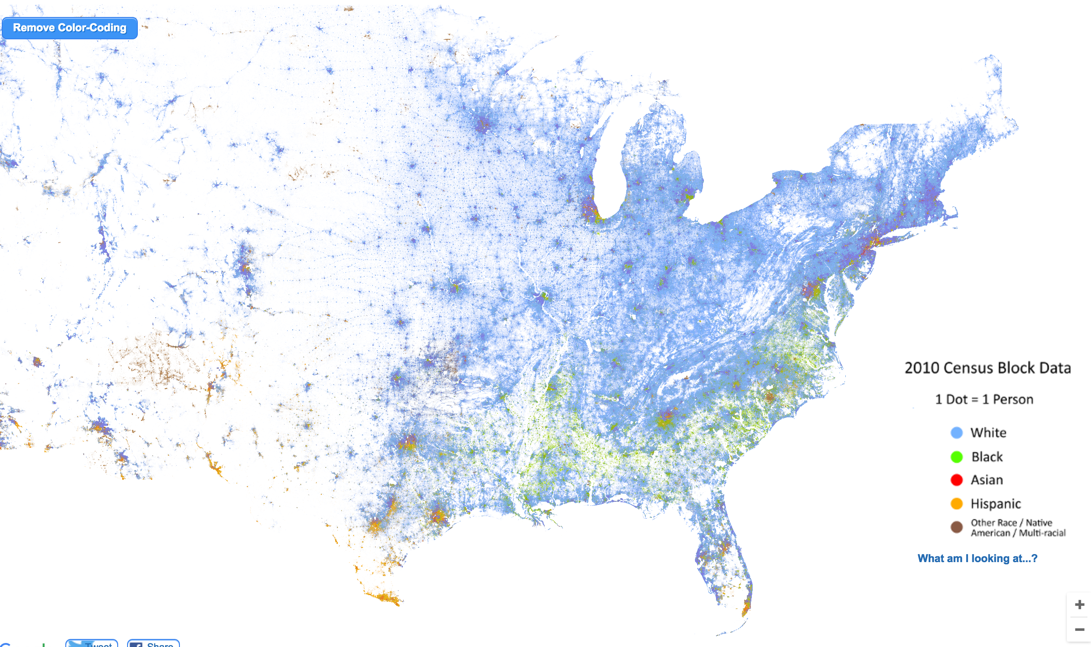
RACIAL DOT MAP
https://demographics.virginia.edu/DotMap/

Slide 13
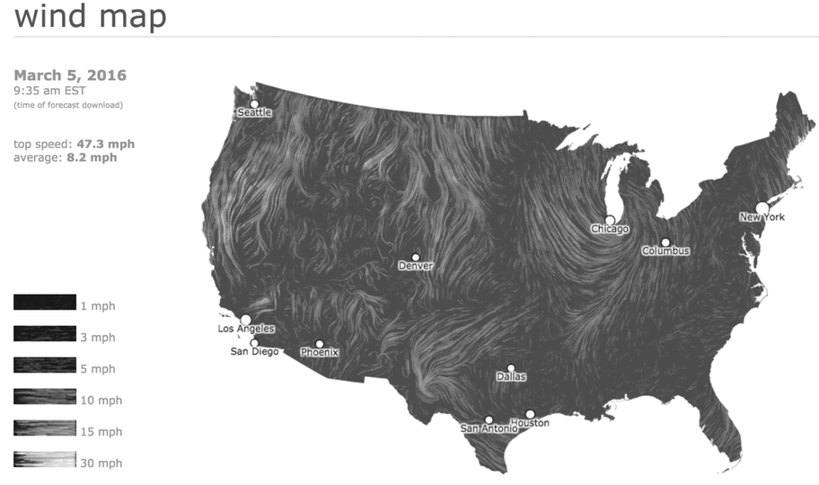
WIND MAP
http://hint.fm/wind/

Slide 14
DATA VISUALIZATION
But what visual representations best align with our perceptual capabilities?

Slide 15
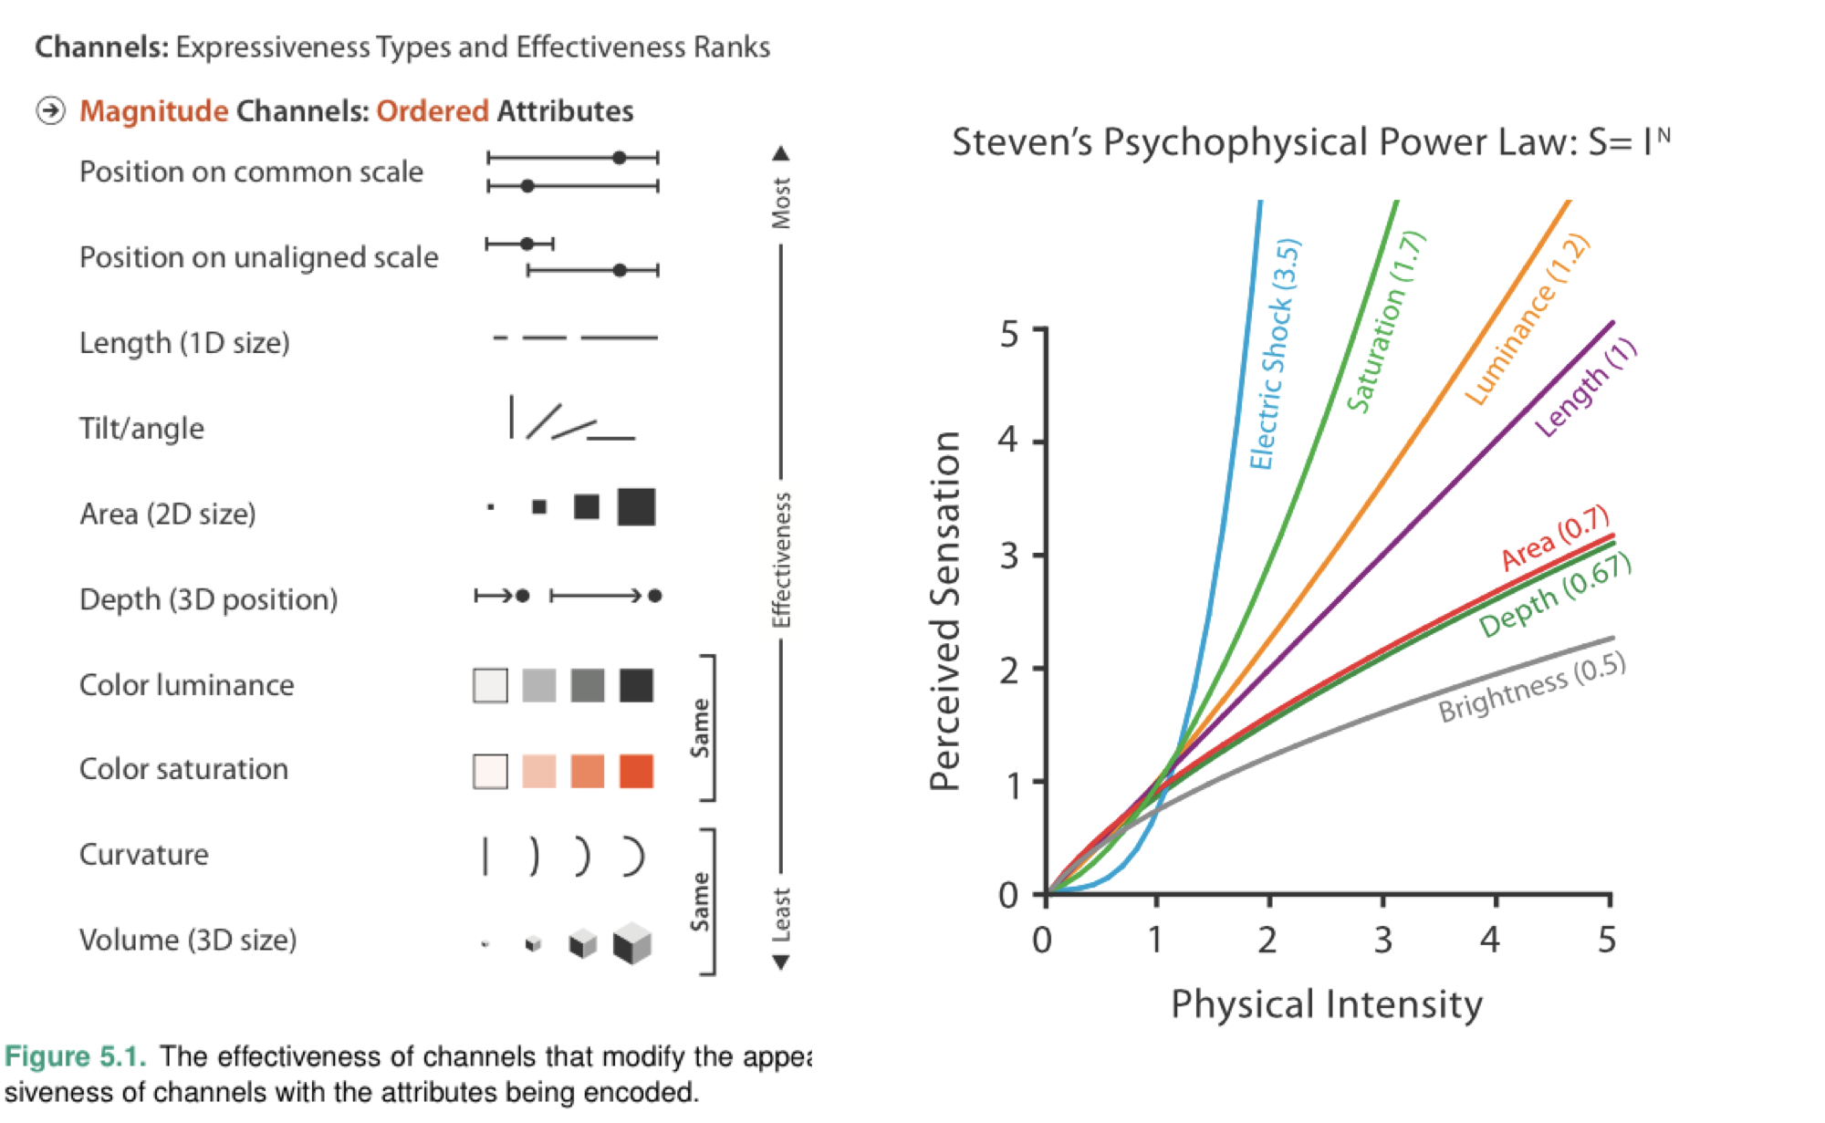
If data is represented using some visual features, we know from psych studies whether people are likely to underestimate or overestimate the data

Slide 16
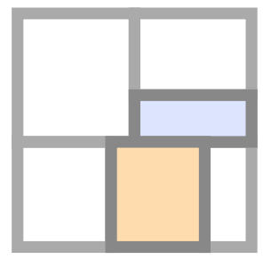








See if you can rank these graphs
TREEMAP
STACKED
BAR GRAPH
BUBBLE
CHART
PIE CHART

Slide 17
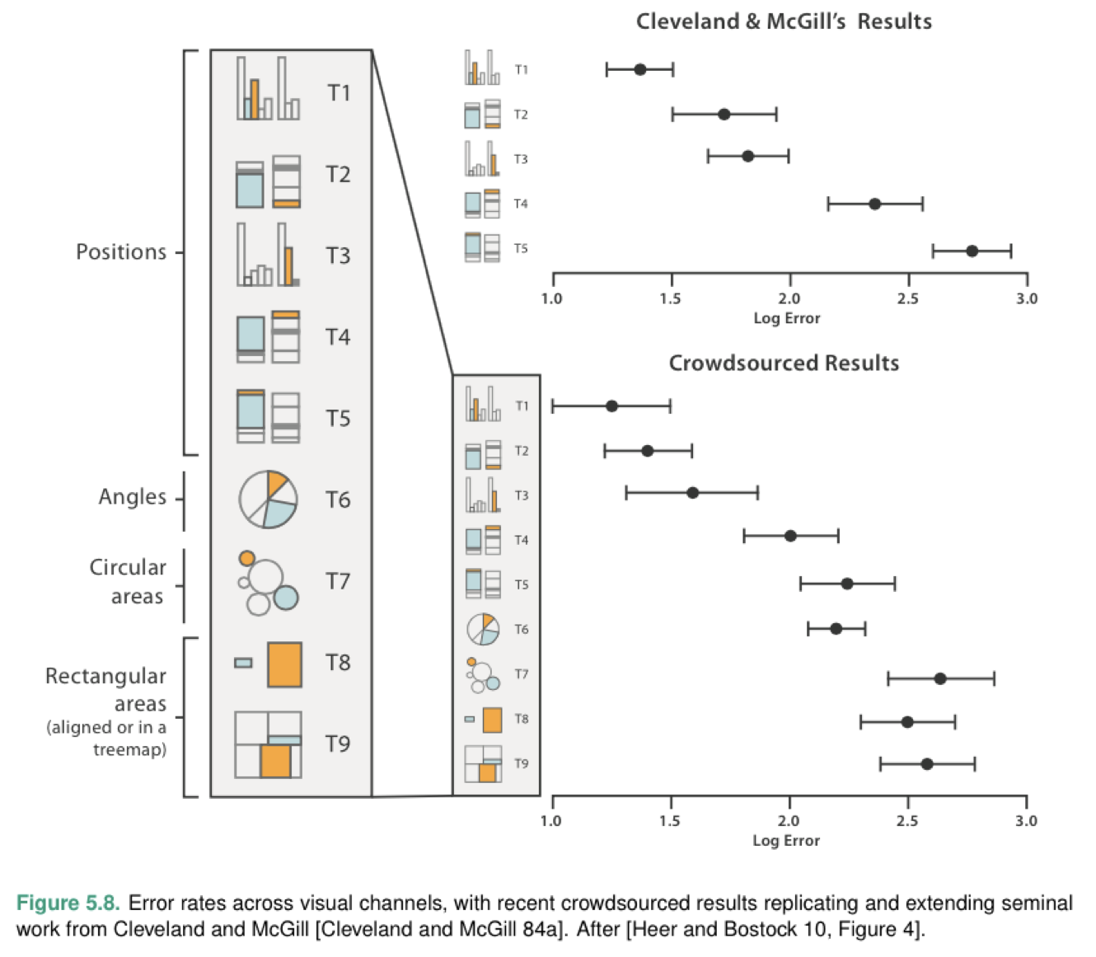
Some graphs support comparisons. Others distort them. bar graphs > pie charts

Slide 18
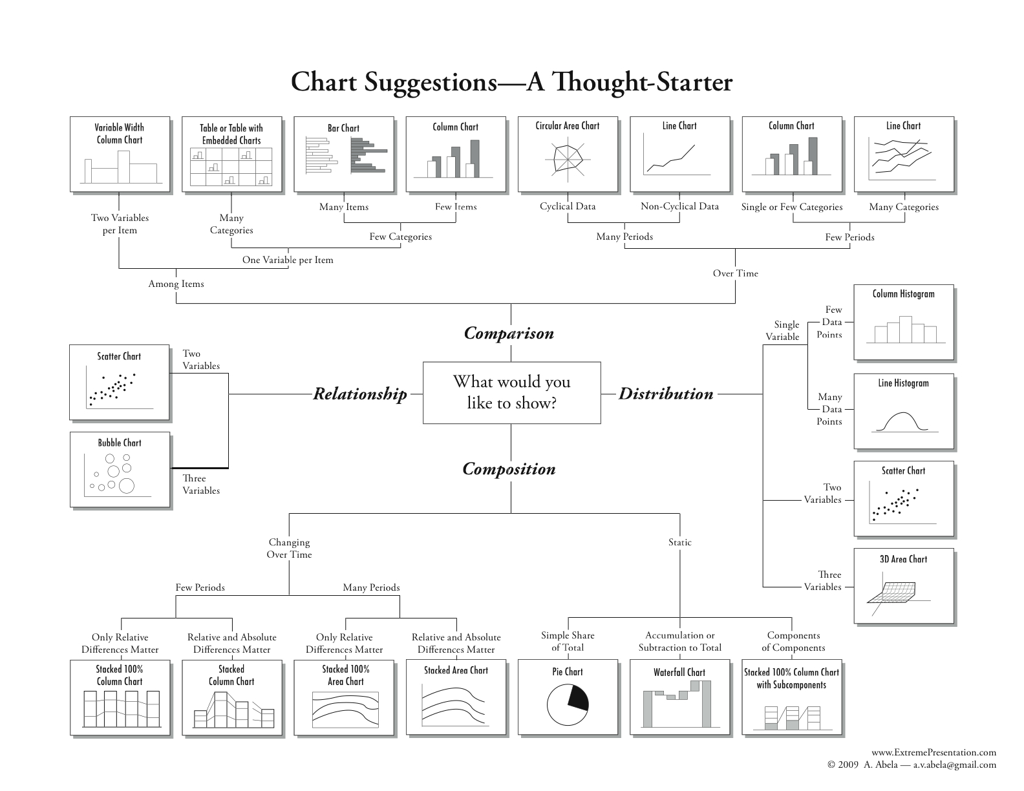
It’s critical to choose the right chart

Slide 19
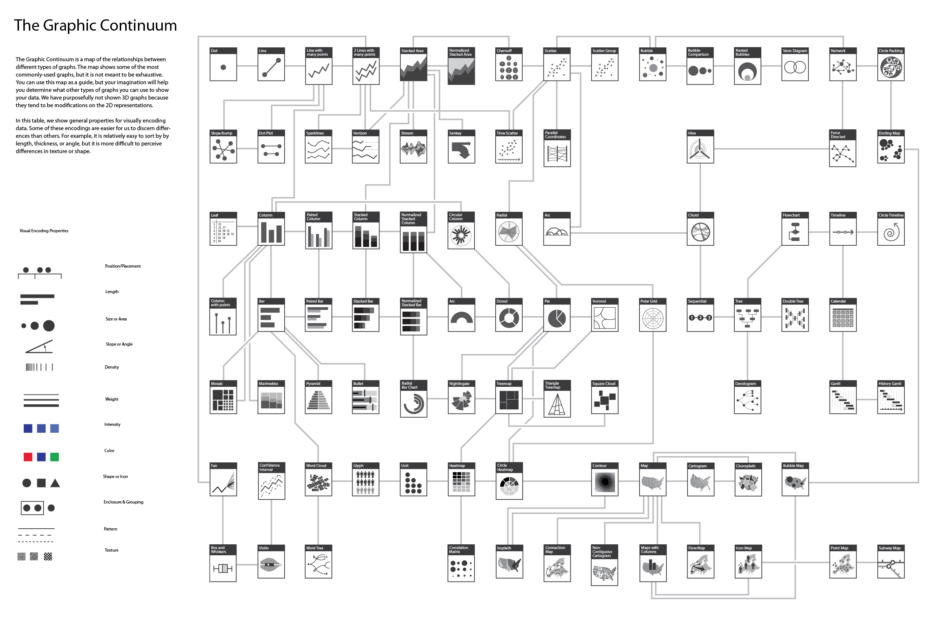
There are MANY visual representations

Slide 20
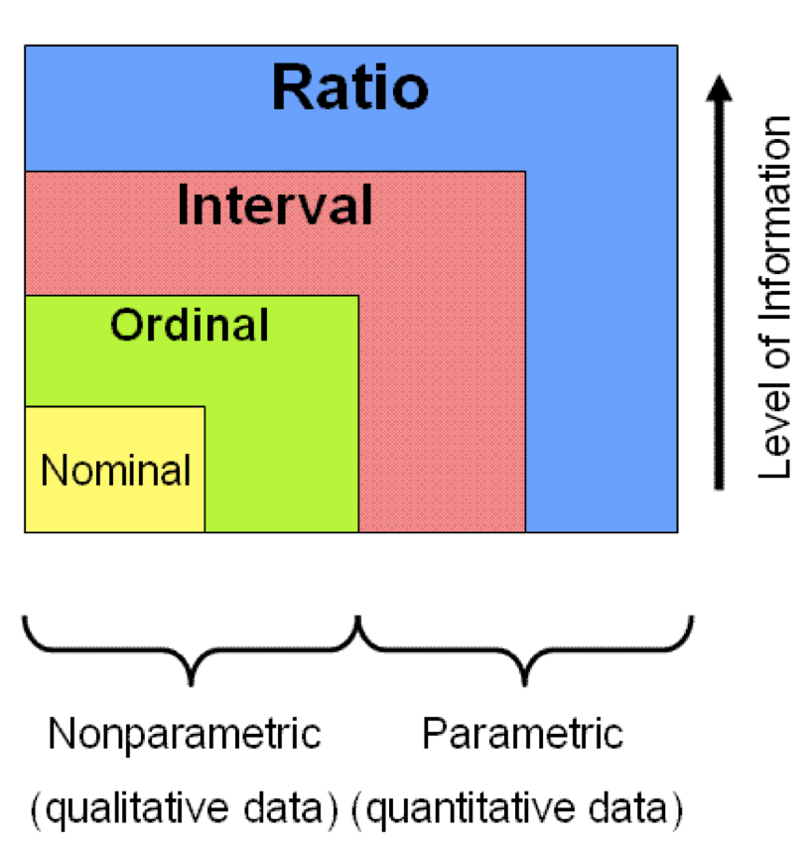
The TYPE of your data matters too

Slide 21
NOMINAL
apple, orange, pear
hate, dislike
neutral, like, love
ORDINAL
INTERVAL
2°, 4°, 20°, 85° C
RATIO
$2, $4, $20, $85

Slide 22
You need different kinds of representation for different kinds of data.

Slide 23
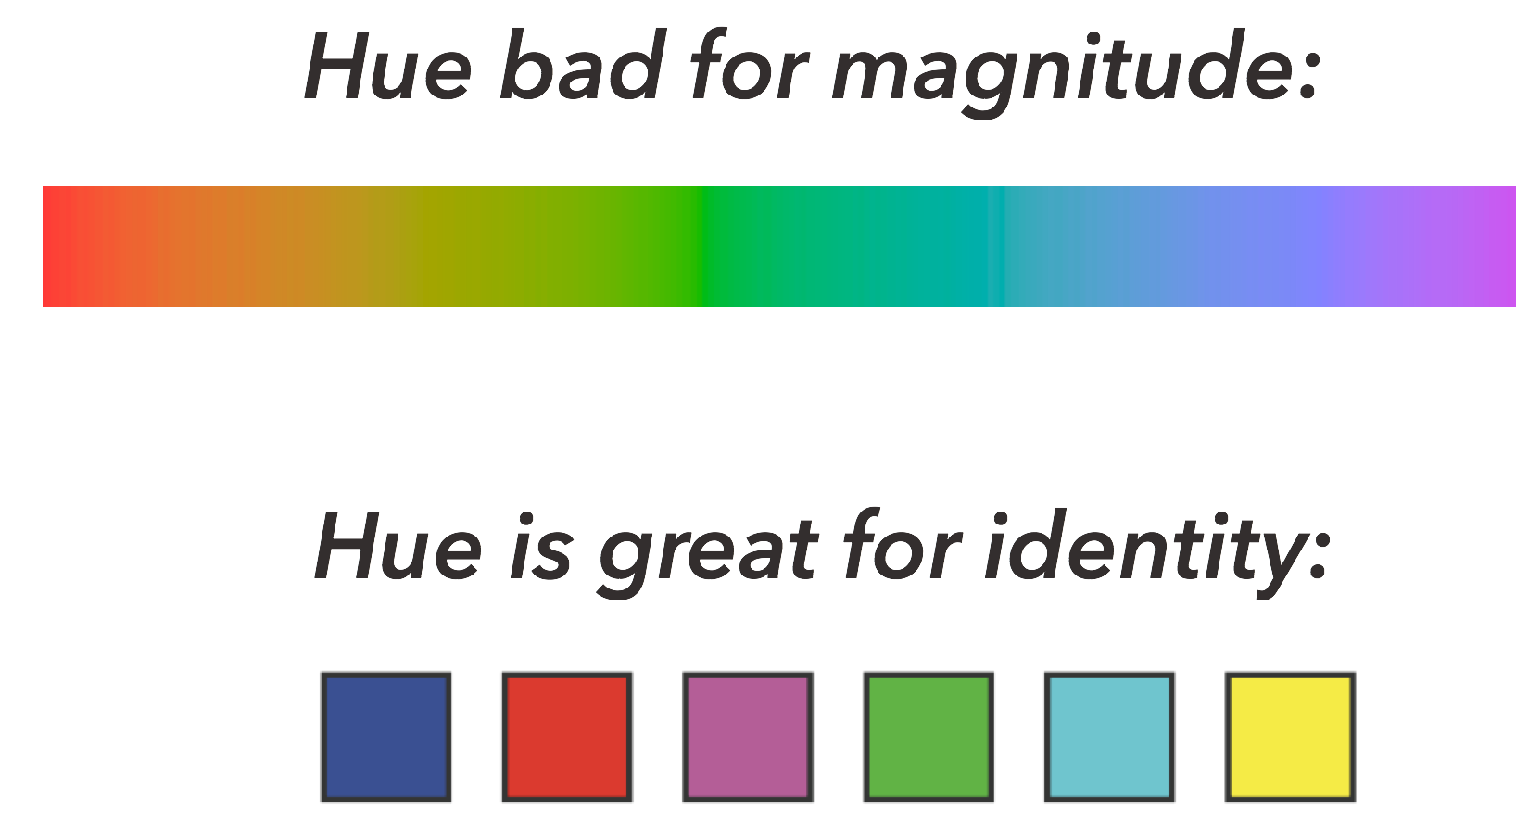
HUE: RATIO vs. NOMINAL
And some visual mappings are better suited for specific kinds of data

Slide 24
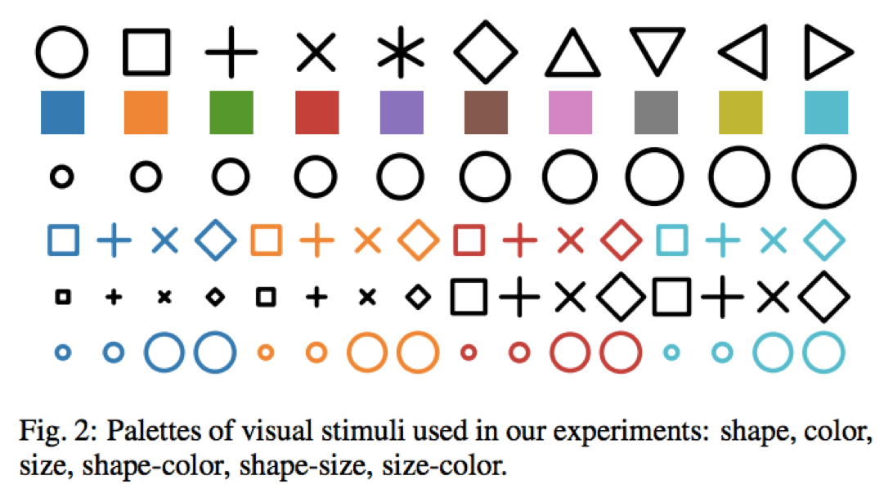
What if you had nominal categories and needed to represent them with symbols? You want symbols that people can easily distinguish…
but how do we know what works best?

Slide 25
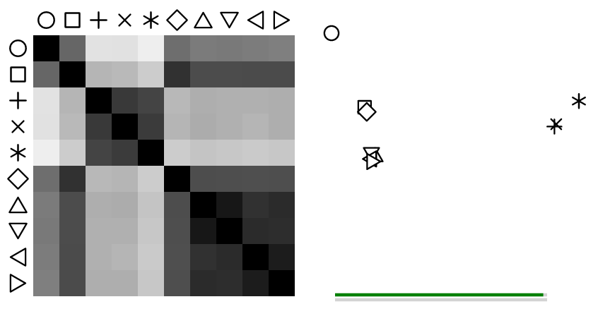
Perceptual Kernels
Jeff Heer
We actually know which ones people perceive as most different!
For shape, color, size, shape + color, shape + size, size + color

Slide 26
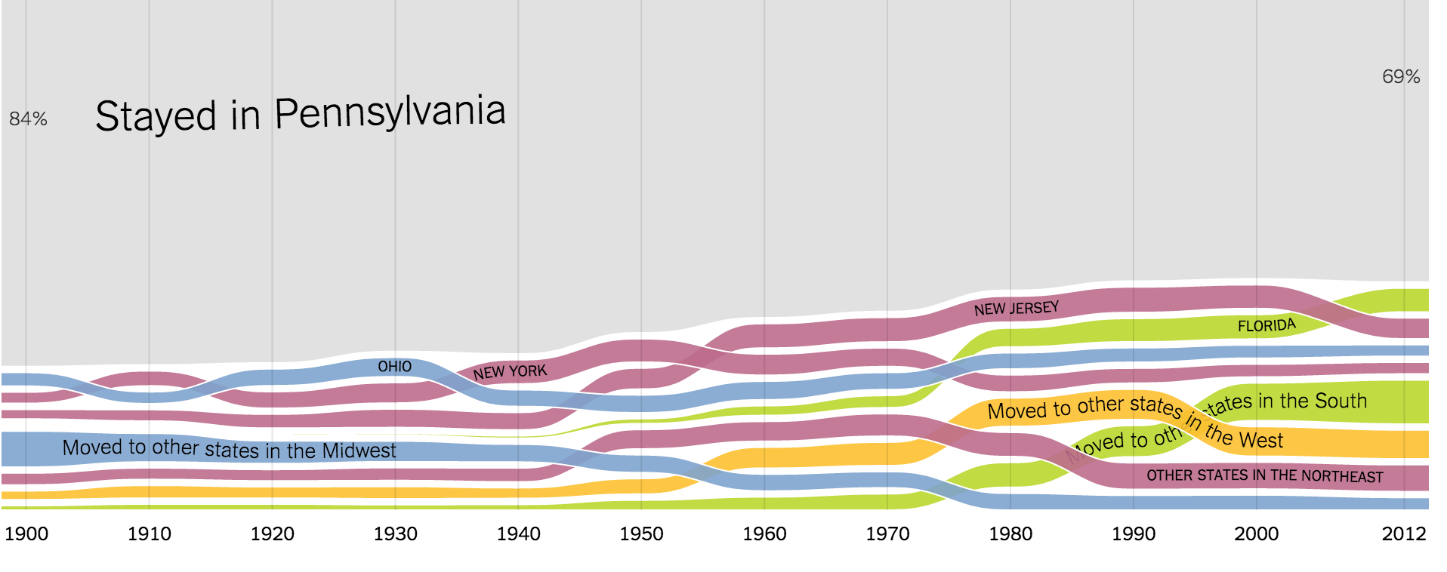
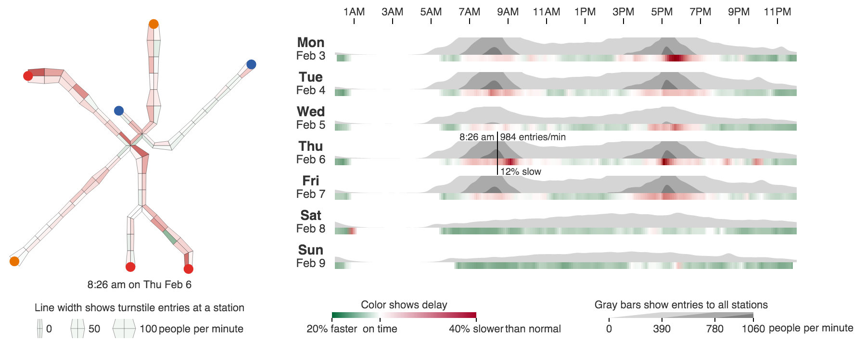

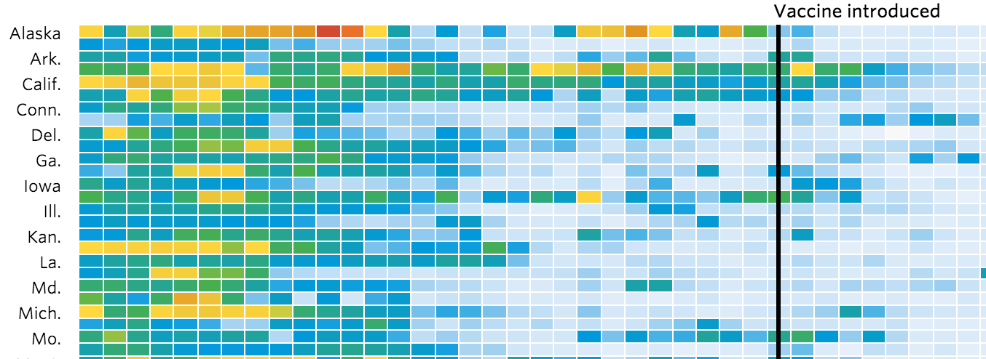
VIS DESIGN PRINCIPLES II

Slide 27
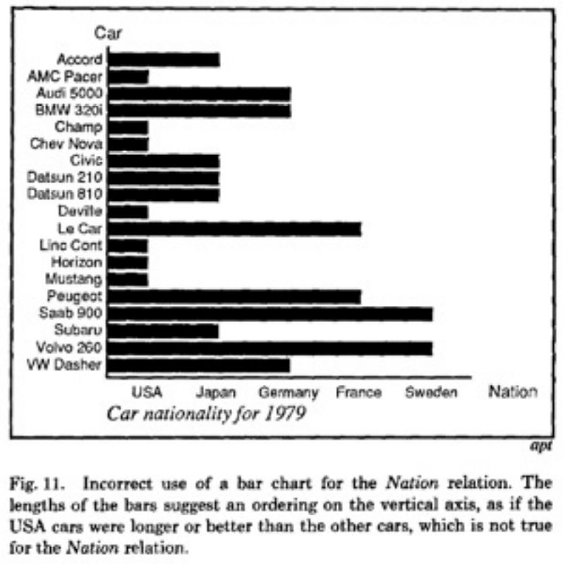
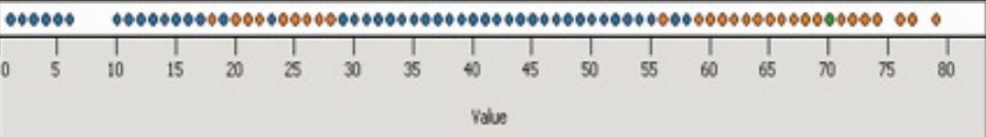
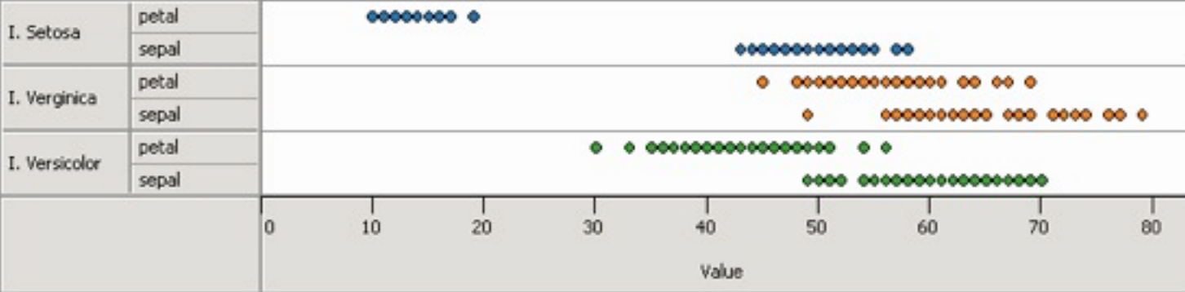
Jock D. MacKinley
DESIGN CRITERIA: EXPRESSIVENESS
A visual encoding be capable of expressing all of the facts in a set of data, and should not accidentally express more information that may be interpreted as facts.
Cannot express all the facts
Expresses too many facts

Slide 28
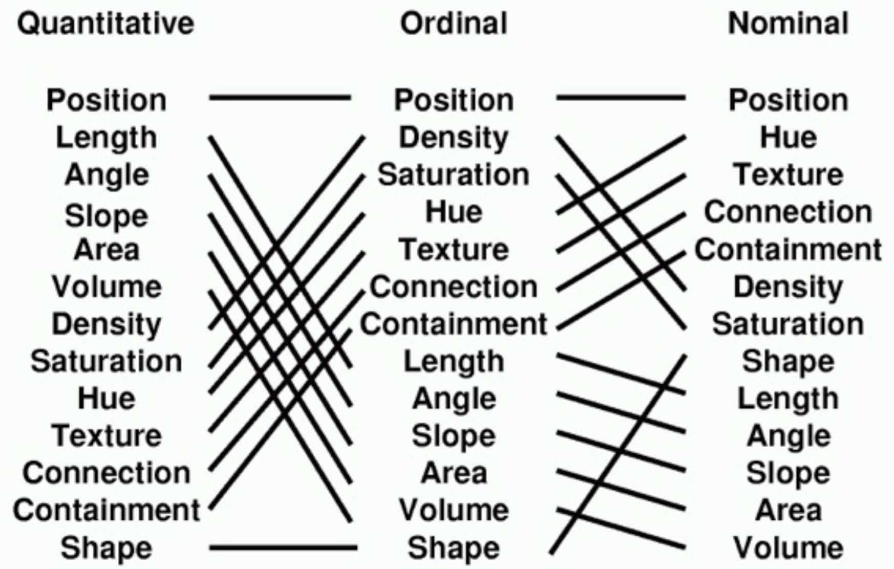
DESIGN CRITERIA: EFFECTIVENESS
A visualization is more effective than another one if the information conveyed by the visualization is more readily perceived than the information in the other visualization.

Slide 29
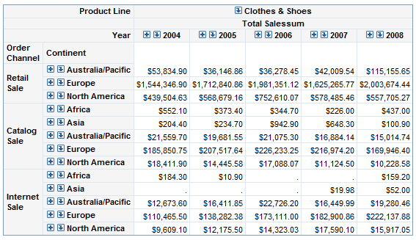
MAPPING DATA → VISUAL VARIABLES This is a challenge. The real world has n-dimensional data

Slide 30
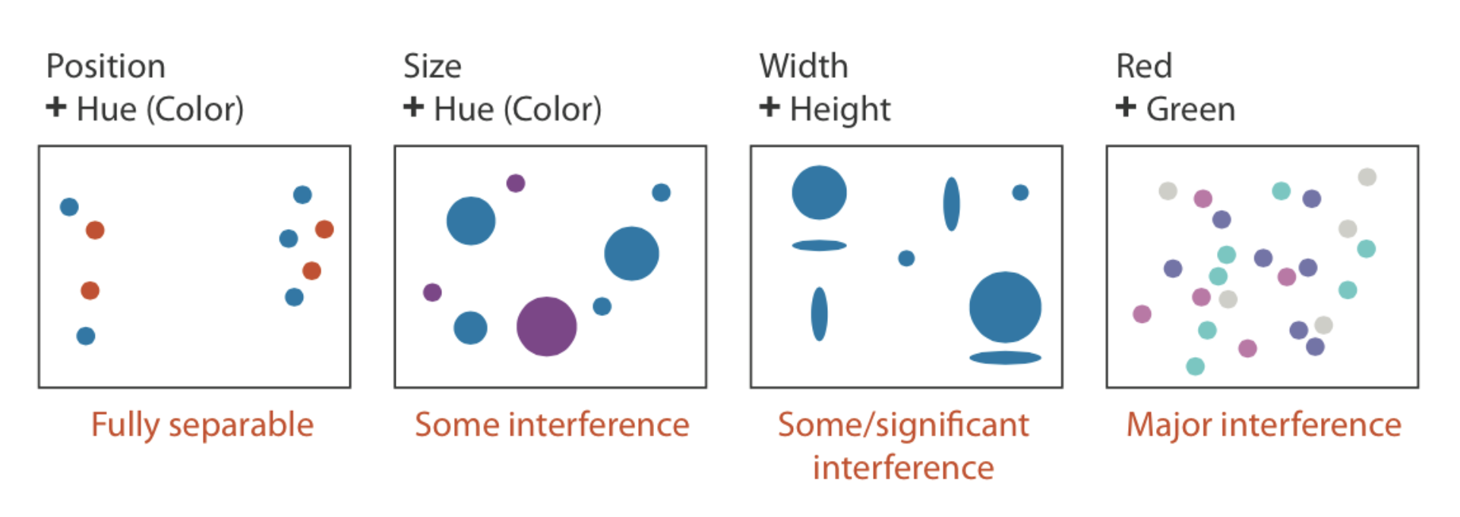
SEPERABLE vs. INTEGRAL
When you are choosing multiple visual features to map data to, you have to make sure that the visual features don’t interfere with each other (they are seperable)

Slide 31
How many variables?

Slide 32
DESIGN PRINCIPLE: CONSISTENCY
The properties of the images (visual variables) should match the properties of the data
DESIGN PRINCIPLE: IMPORTANCE ORDERING
You sometimes have more data to encode than efficient visual channels to map them to. If you need to, prioritize. Encode the most important information in the most effective way

Slide 33
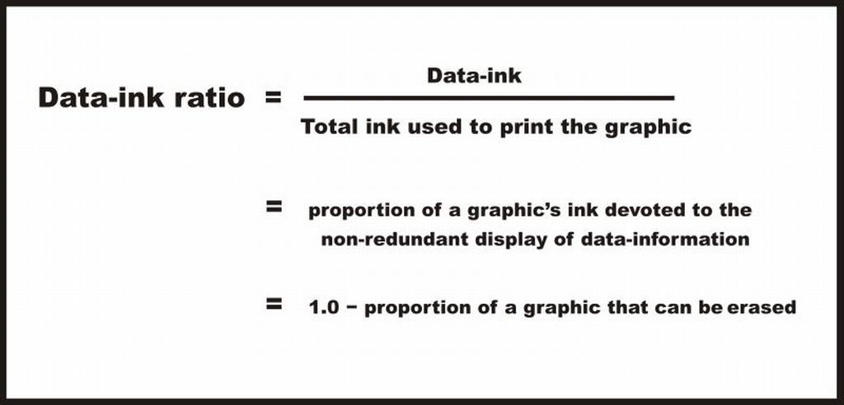
DESIGN PRINCIPLE:
PRIORITIZE IMPORTANT INFORMATION

Slide 34
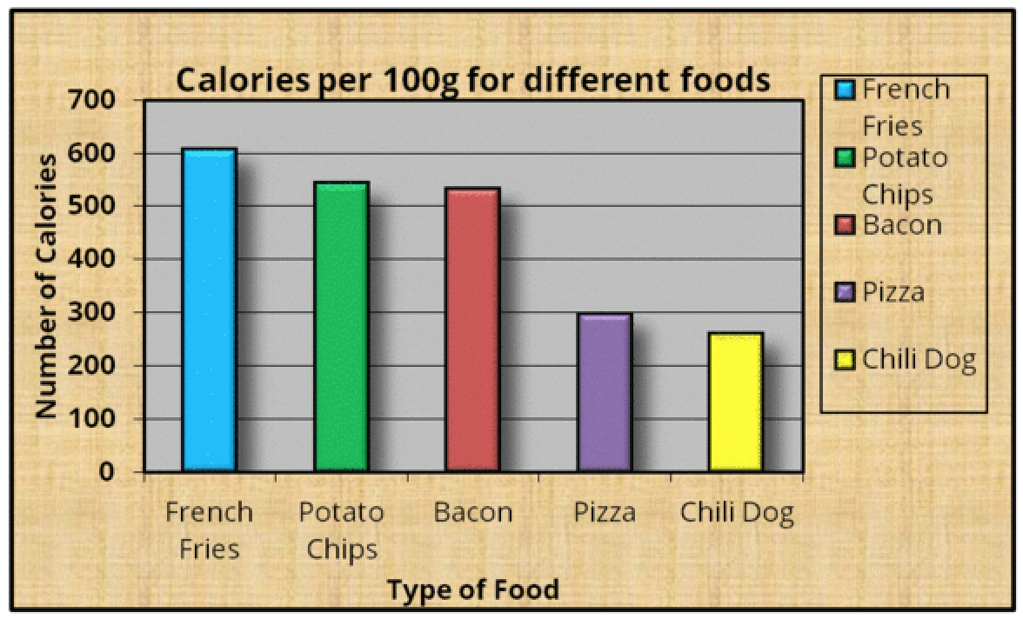
FOR EXAMPLE: SIMPLIFY THIS GRAPH

Slide 35
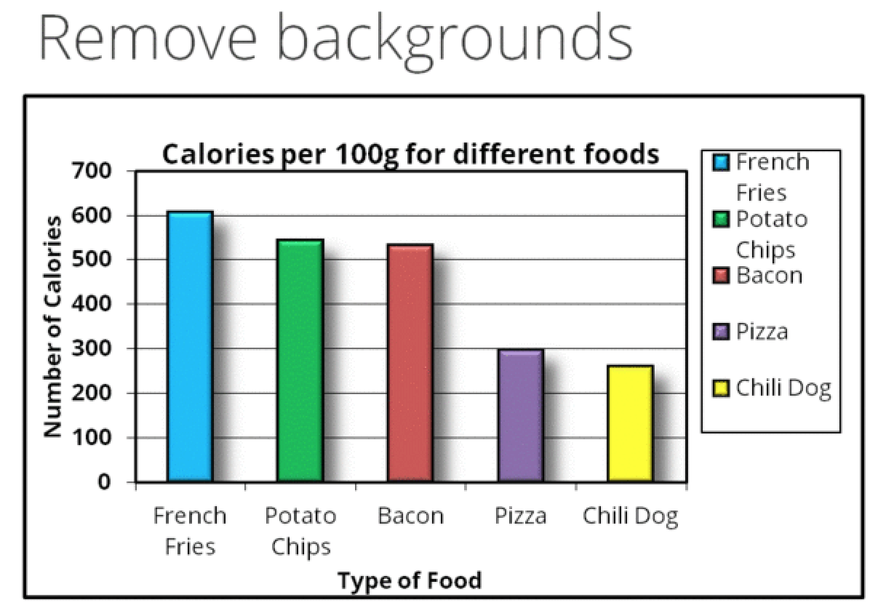

Slide 36
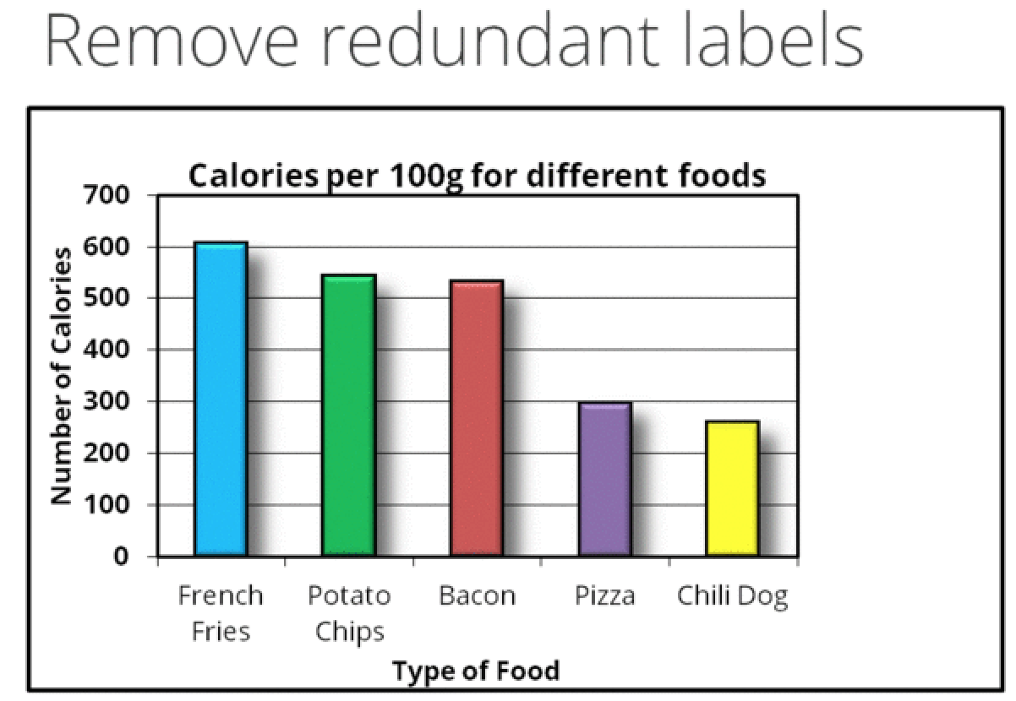

Slide 37
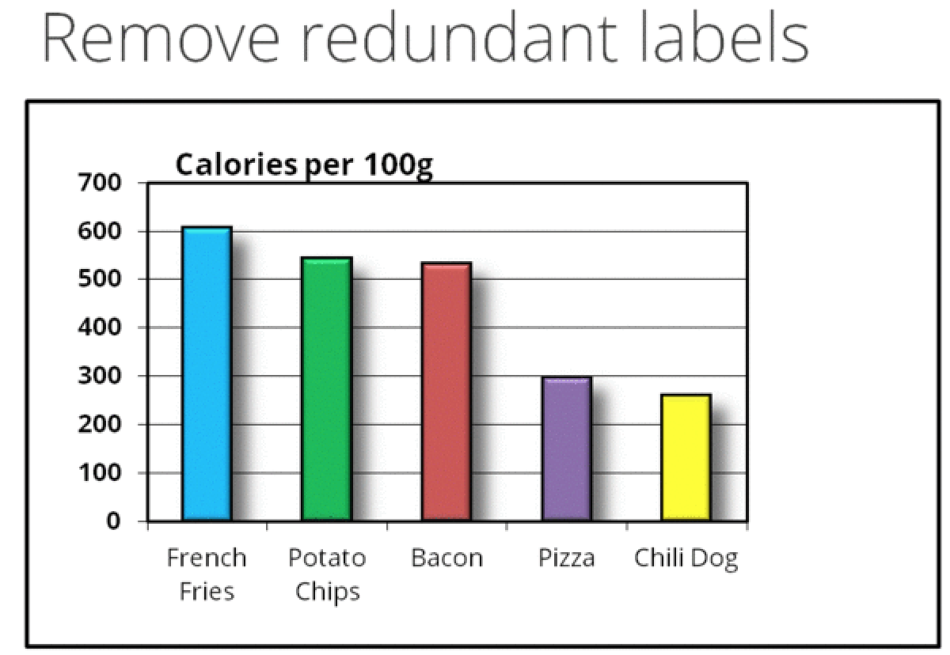

Slide 38
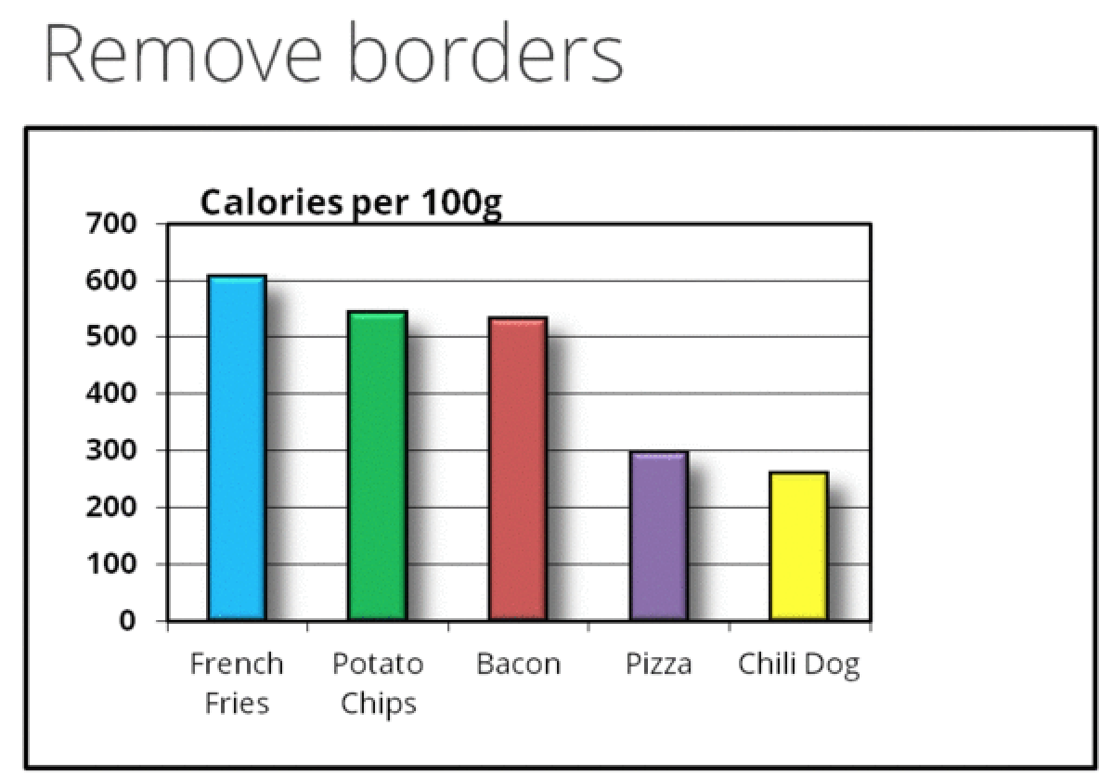

Slide 39
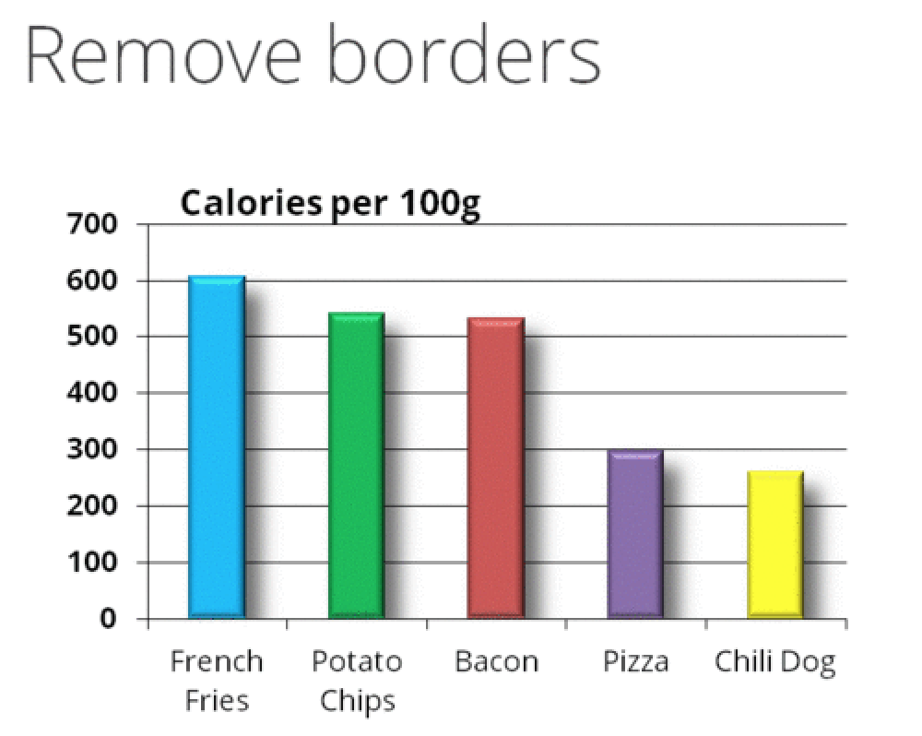

Slide 40
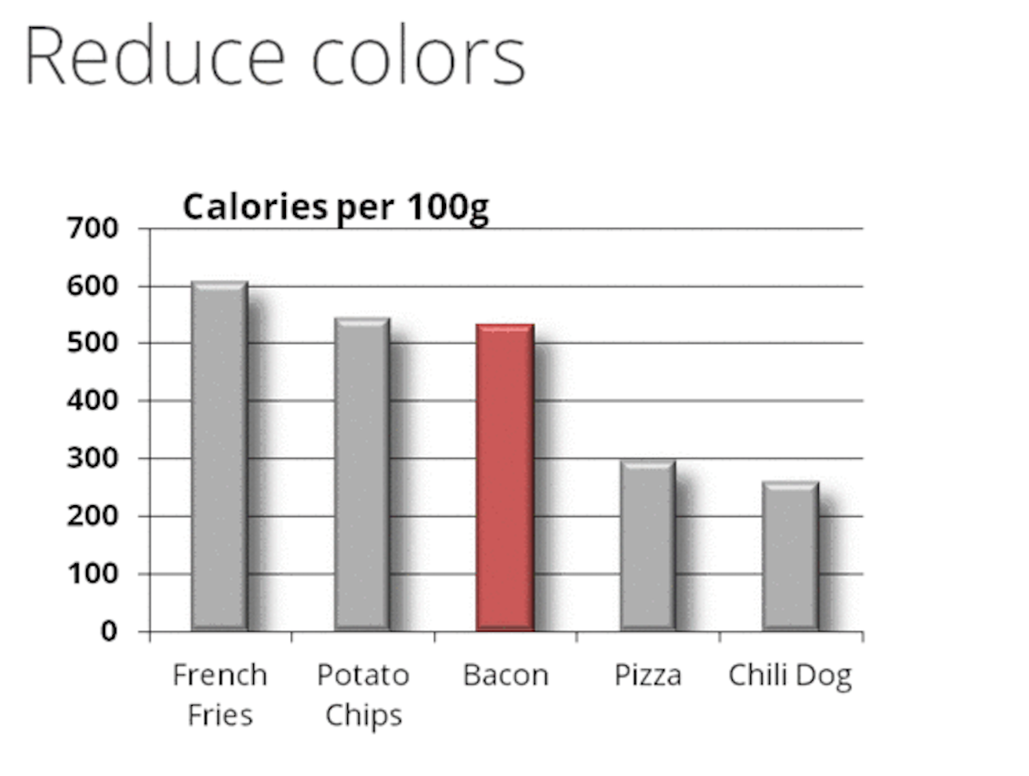

Slide 41
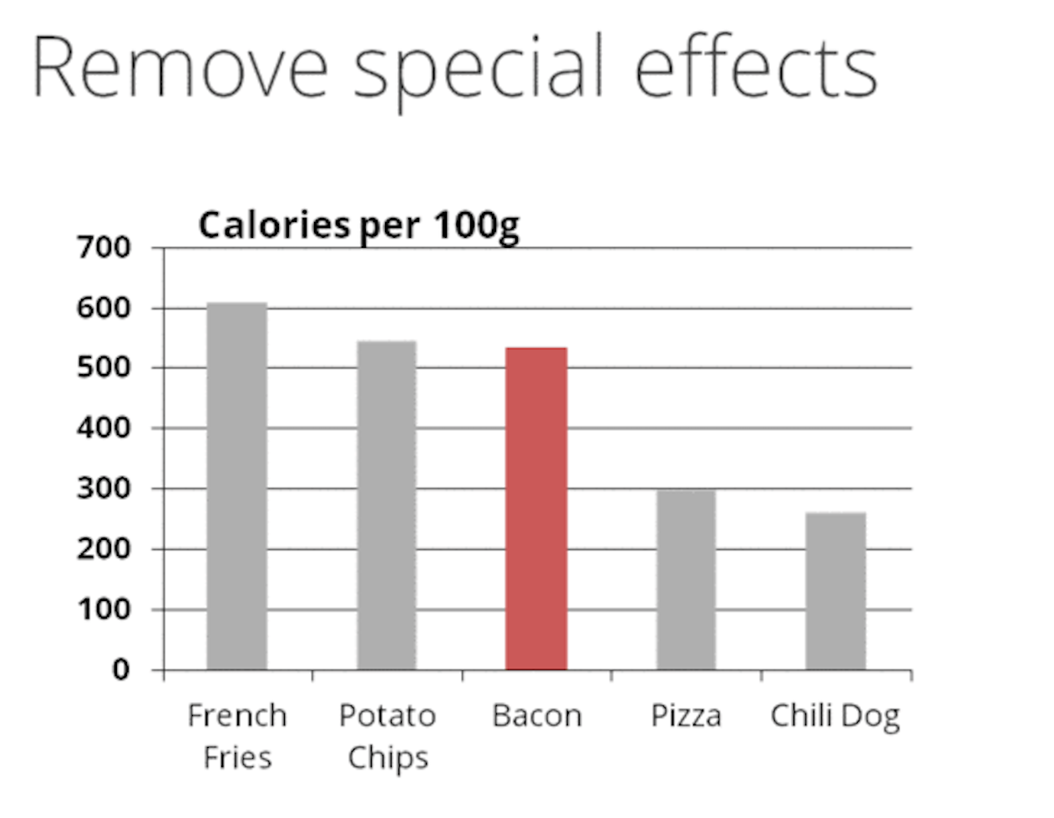

Slide 42
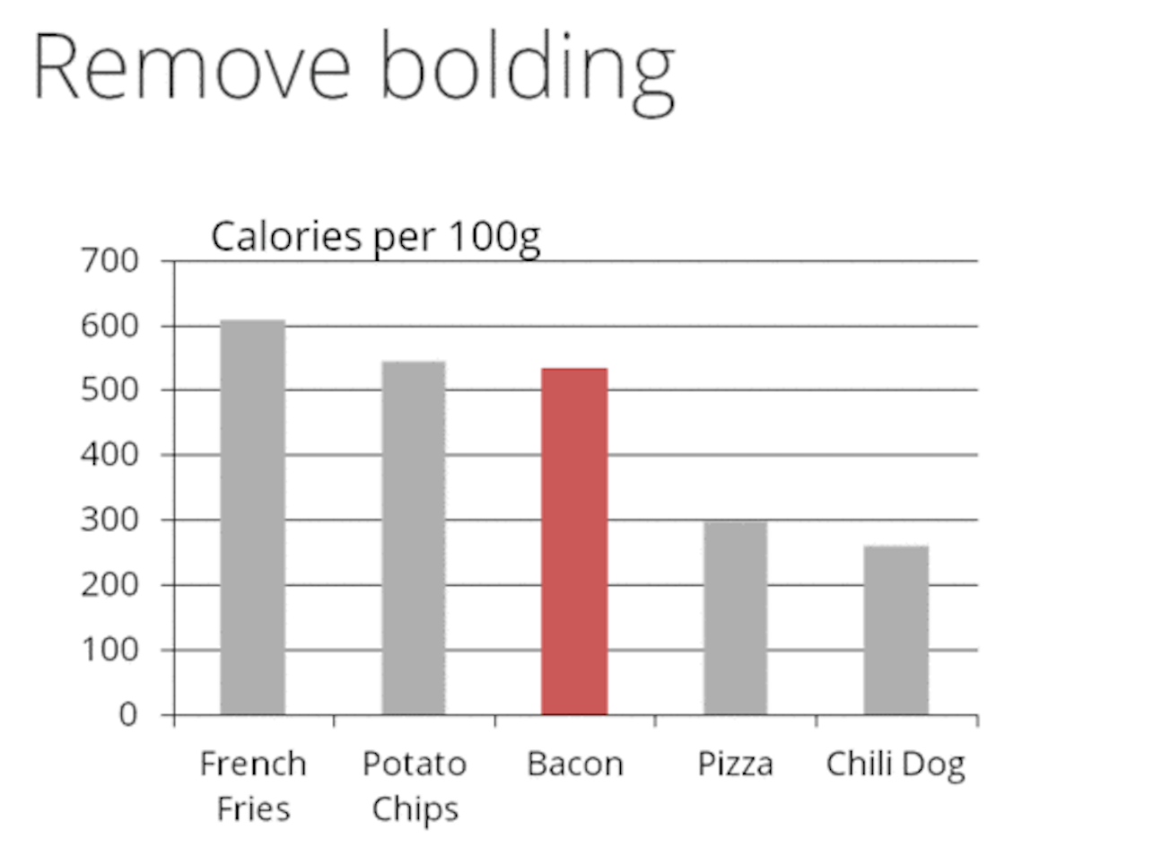

Slide 43
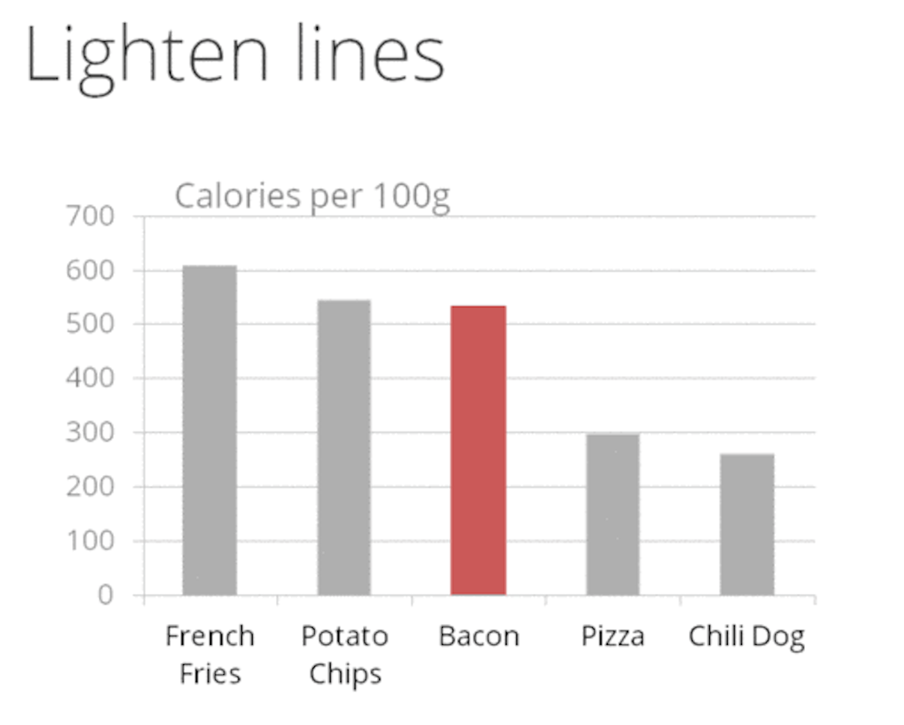

Slide 44
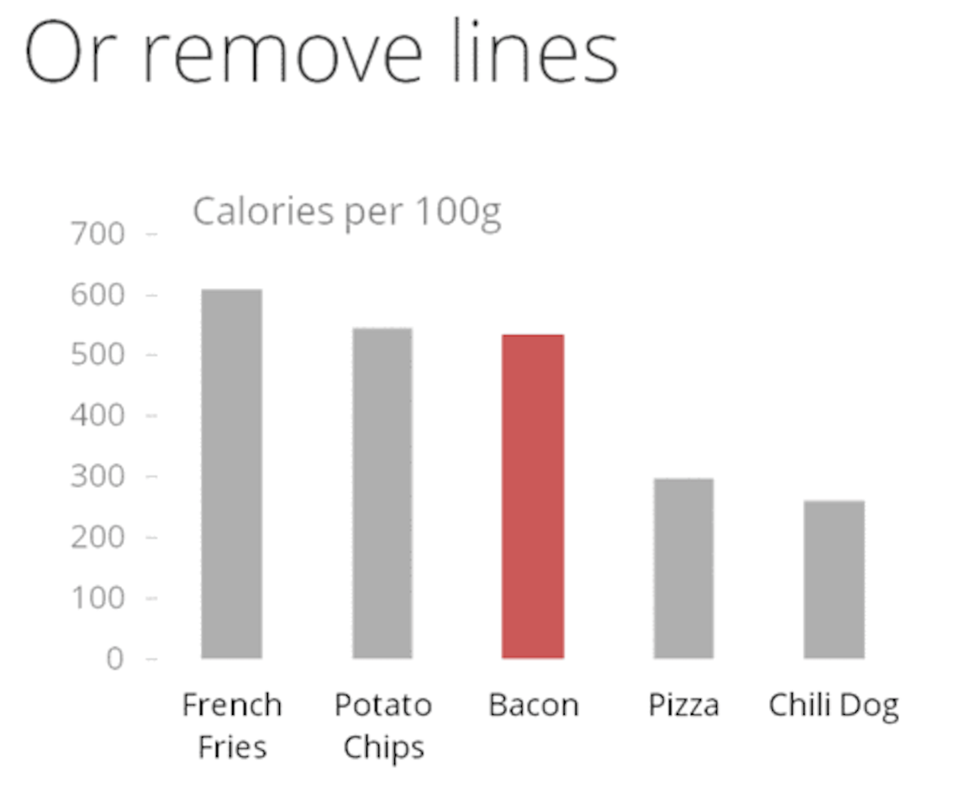

Slide 45
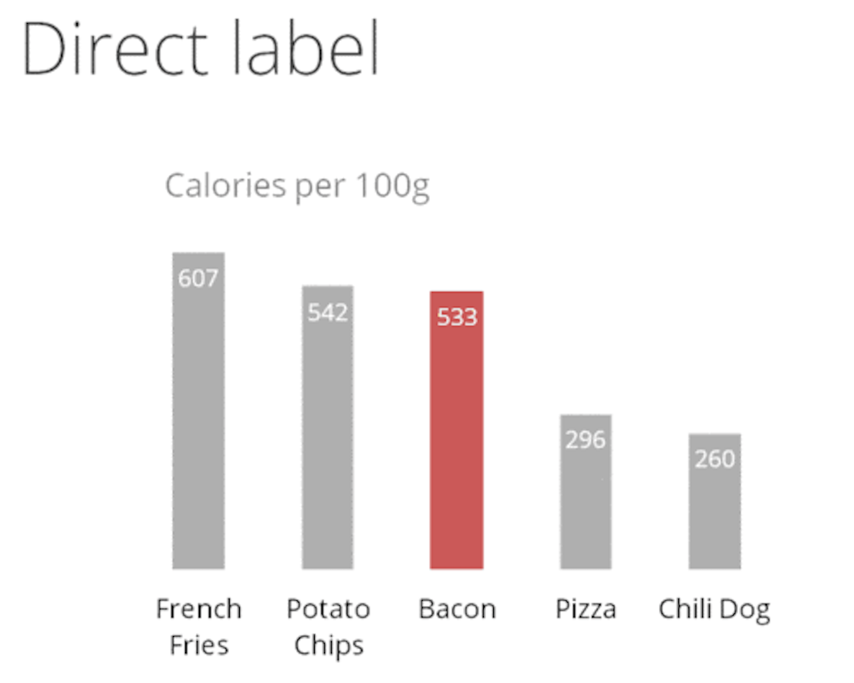

Slide 46
WHICH
IS
BETTER?

Slide 47

GOOD OR BAD?

Slide 48
GOOD OR BAD?
Better?
James Provost

Slide 49

GOOD OR BAD?

Slide 50
GOOD OR BAD?
Better?
It depends who you ask….
James Provost

Slide 51

For pure understanding, we know that simple is better. But people are complex..
… maybe you care more a memorability? Maybe you can more about
persuasion? How does that impact design guidelines? ← OPEN RESEARCH

Slide 52

GOOD OR BAD?
James Provost

Slide 53
GOOD OR BAD?
James Provost

Slide 54

(Accidentally?) MISLEADING
Tricks our perception

Slide 55

Breaks convention

Slide 56

• A movie ticket in 1929 was $4.32. A ticket in 2009 is $7.20 - A price increase of 66%
• Popcorn in 1929 was $0.62. Popcorn in 2009 is $4.75 - A price increase of 666%
Wrong encoding

Slide 57

LIE FACTOR
Popcorn Height: +666%
Popcorn Area: +4500%
Lie Factor: 6.75

Slide 58


This is better…..

Slide 59

WHAT’S WRONG?

Slide 60


Slide 62


Slide 63

GOOD OR BAD?

Slide 64


Slide 65


Slide 66



Slide 67

For the love of god, don’t use 3D visualizations
occlusion + depth

Slide 68
LIES
DAMN LIES
AND STATISTICS

Slide 69


Slide 70
For bar graphs, y-axis should start at 0

Slide 71


Slide 72
Dual-axis charts are DANGEROUS

Slide 73

On same plot. Notice how charts can be used as rhetoric! Reframing tells different stories!

Slide 74
VISUALIZATION RHETORIC

Slide 75

Note: This is a gif.
You’ll need presentation mode to see it animate

Slide 76


TWO VISUALIZATIONS OF THE 2016 ELECTION
County Map of Election
Counties Scaled by Population
Which is better?
Answer: Neither. Both manipulate your perception to tell a story. LEFT: rural areas are over-represented by mitigating densely populated areas. RIGHT: urban areas are over-represented by mitigating vast expanses of land.

Slide 77


Slide 78


Slide 79


Slide 80
Don’t scale y-axis without context

Slide 81
TAKEAWAY
Data visualization literacy is CRITICAL for
1. being able to communicate effectively to people in a way that best fits their brains.
2. being able to see through bullshit.

